Slide 1
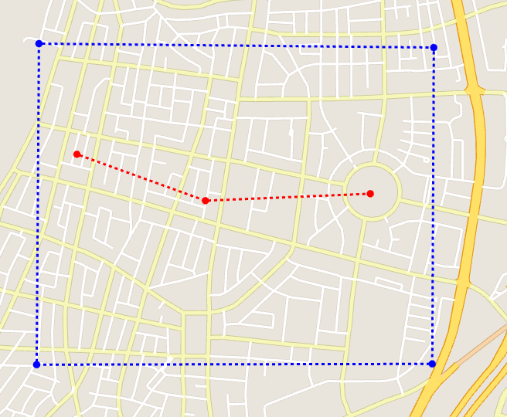
ex_feature_tel-aviv2.xml

Slide 2
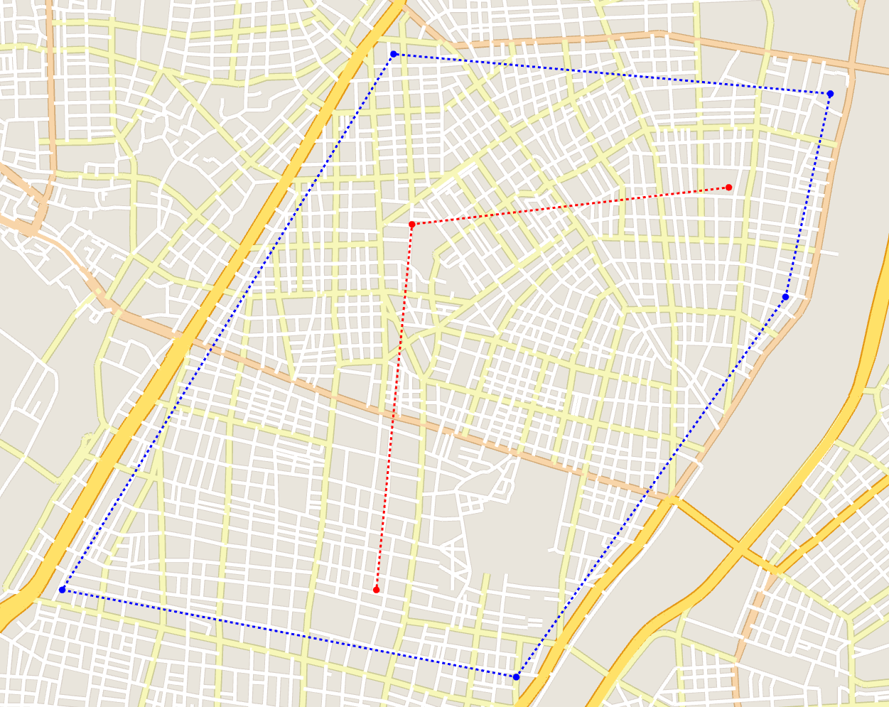
ex_feature_tokyo1.xml

Slide 3
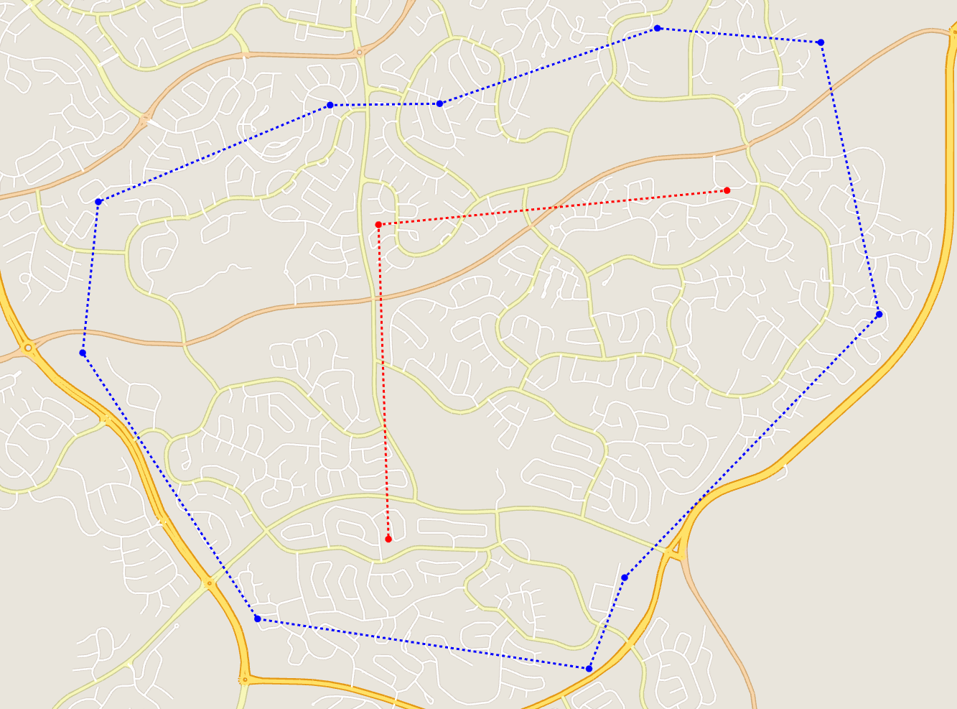
ex_feature_canberra.xml

Slide 4
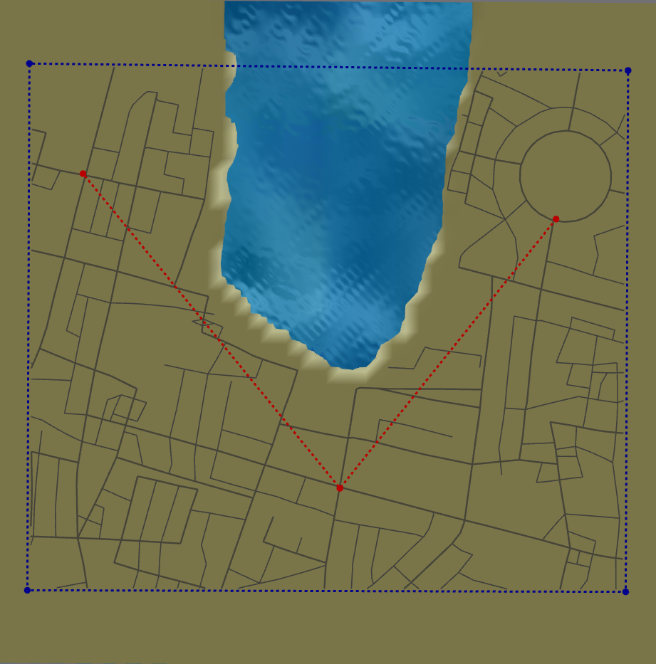
1. Weird Shape Fitting (adaptive generation to topology and user-defined areas)

Slide 5
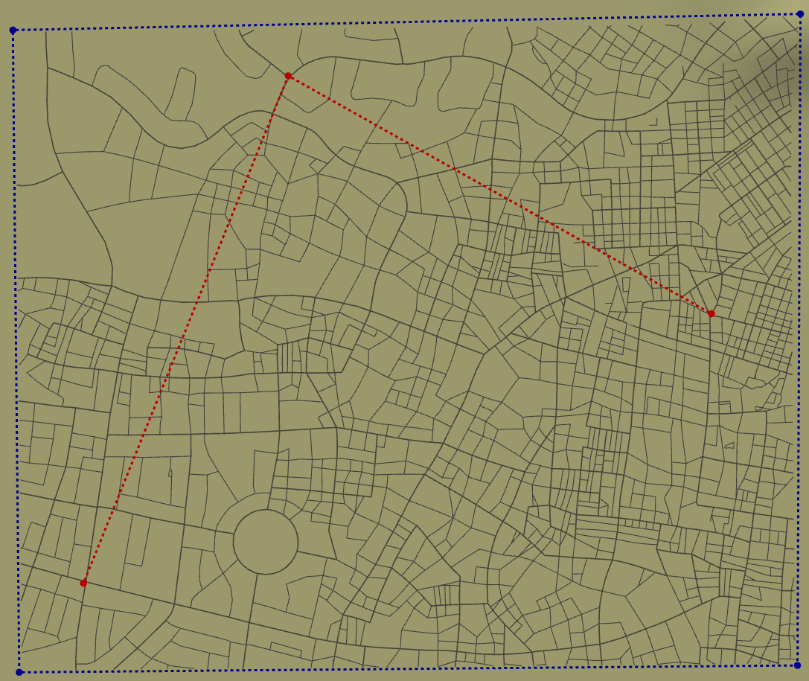
2. Multiple Examples
Canberra
Tokyo
Tel-Aviv

